Slide 1
Intro to Machine Learning
Week 7 – Tree models and Ensemble Methods

Slide 2
Today’s Class
Decision Trees
Ensemble Methods
Random Forest

Slide 3
Decision Trees
Family of models considered to be one of the best and most widely used in supervised learning.
Known for very high accuracy, stability, and ease of interpretation.
Map non-linear relationships very well.
Can be used for regression or classification
Most commonly for classification
Works for both categorical and continuous input features

Slide 4
Decision Trees - Types
There are multiple types of decision tree models:
CART (Classification And Regression Tree)
Uses Gini index/Gini impurity to figure out how and when to split the attributes
ID3
Uses “Information gain” to figure out how and when to split the attributes
Precursor to C4.5
Used commonly in NLP
C4.5
Also uses “Information gain”, more advanced version of ID3
CHAID (CHi-squared Automatic Interaction Detector)
Performs multi-level splits when computing classification trees
MARS
Extends decision trees to handle numerical data better

Slide 5
Decision Trees – How do they work?
Example:
We have 30 students with three variables: gender, grade, and height.
We want to create a model that can predict who will play cricket during their free time…
Since this is our training data, we know 15/30 students decided to play cricket.

Slide 6
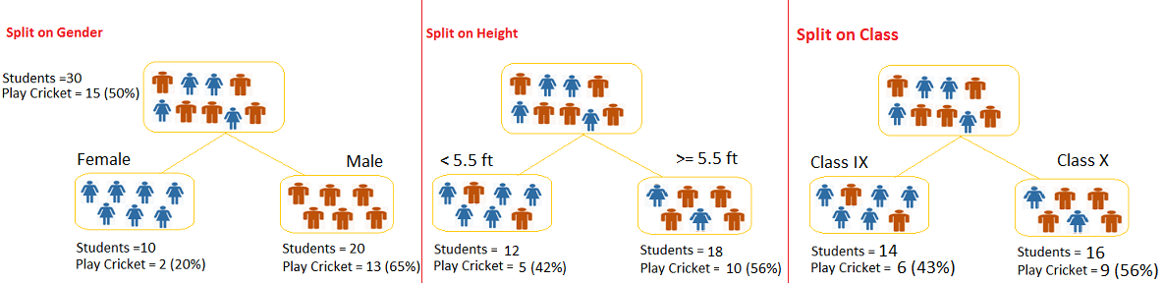
Decision Trees – How do they work?
The model works by identifying the most significant variable and its value that gives the best homogeneous sets of population.
Notes:
Which od these trees would be the best predictor?
Answer = Gender as it creates the classes that have the lowest “impurity”.

Slide 7
Decision Trees – Terminology
Root Node
Represents entire population or sample.
Splitting
Process of dividing a node into two or more sub-nodes
Decision Node:
A node that splits into further sub-nodes based on some attribute.
Leaf/Terminal Node:
Nodes that do not split

Slide 8
Decision Trees – Terminology
Pruning
Removing sub-nodes of a decision node
Opposite of splitting
Branch/Sub-tree
A sub-selection of entire tree
Parent and Child Node:
Parent node = a node which is divided into sub-nodes
Child node = a sub-node of a parent node

Slide 9
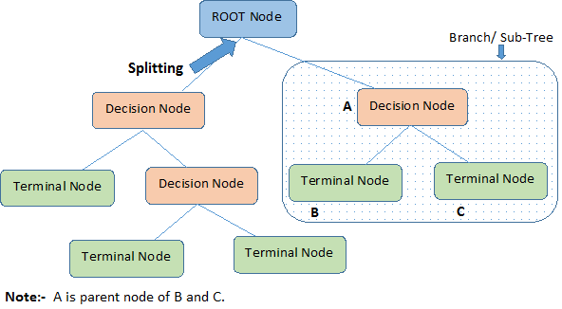
Decision Trees – Terminology
Notes:
- General rule is True = left side split, False = Right

Slide 10
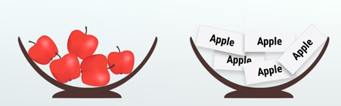

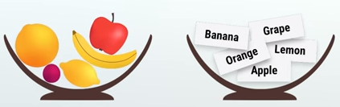
Decision Trees - Impurity
Impurity = Chance of being incorrect if we were to randomly assign a label to an example in the same set.
Example on impurity…
Lets say we have two bowls:
What will happen if we randomly draw a fruit from the first bowl and a label from the second?
What about in this example with 5 different fruit and 5 different labels?
Gini Impurity = 1 – (5/5)^2 = 0
Gini Impurity = 1-(1/5)^2 - (1/5)^2 - (1/5)^2 - (1/5)^2 - (1/5)^2 =

Slide 11

Decision Trees – How does it decide how to split?
There must be logic behind the placement of certain attributes in the tree…
The key point to building a highly accurate tree is by knowing which “questions” to ask and when! T
1) Gini Index/Impurity:
Measure of the uncertainty at a single node
Binary splits only
The higher value of “Gini”, the more homogenous the sub-nodes
Used by CART models
2) Information Gain:
Used as metric for splitting by various other decision tree types

Slide 12
Decision Trees – Example Using Gini Impurity
Lets try an example using some sample data…
Lets say we have a bunch of data on heart disease and are trying to create a decision tree based upon three variables: chest pain, good blood circulation, and blocked artery status.
How does Gini impurity help us build our model?
Notes:
- Very simple example, looking here at only binary variables

Slide 13
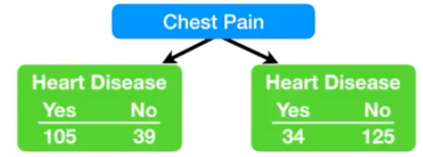
Decision Trees – Example Using Gini IMpurity
Left Side = Chest pain, Right side = No chest pain
Gini Impurity for each leaf = 1 – (probability of “yes”)^2 – (probability of “no)^2
Chest pain leaf node = 1 – (105/105+39)^2 – (39/105+39)^2 = 0.395
No chest pain leaf node = 1 – (34/34+125)^2 – (125/34+125)^2 = 0.336
We now need to calculate the total gini impurity for this question by taking a weighted average of the above values…
Total gini impurity for chest pain = (144/144+159)*0.395 – (159/144+159)*0.336 = 0.364

Slide 14
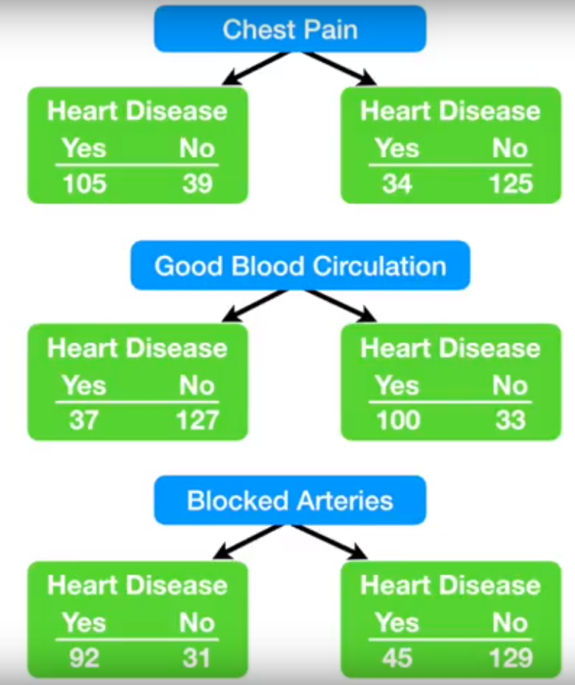
Decision Trees – Example Using Gini Impurity
Gini impurity for Chest Pain = 0.364
Gini impurity for Good Blood Circulation = 0.360
Gini impurity for Blocked Arteries = 0.381
Which should we use to divide our root node?
Good Blood Circulation should be the first split in our tree, as it has the lowest Gini impurity.
What should we use to split next?

Slide 15
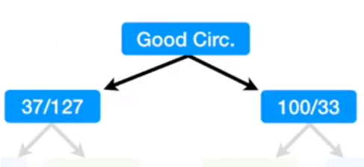
Decision Trees – Example Using Gini Impurity
This is where we are now…
The numbers represent the heart disease split for each answer to the question.
Lets dive into the good circulation group on the left and find what the next step should be.
Should we use Chest Pain or Blocked Arteries to split these further?

Slide 16
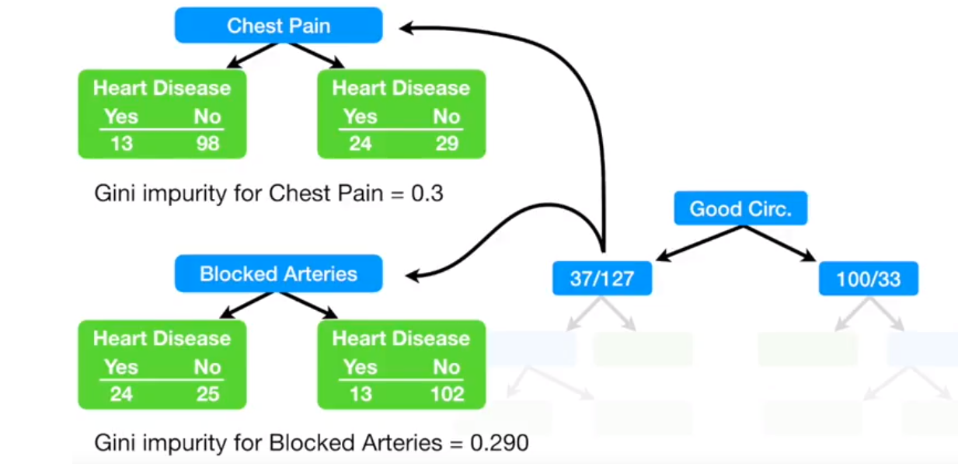
Decision Trees – Example Using Gini Impurity
Which should we use to further separate the patients in this node?
Blocked arteries due to the lower impurity!

Slide 17
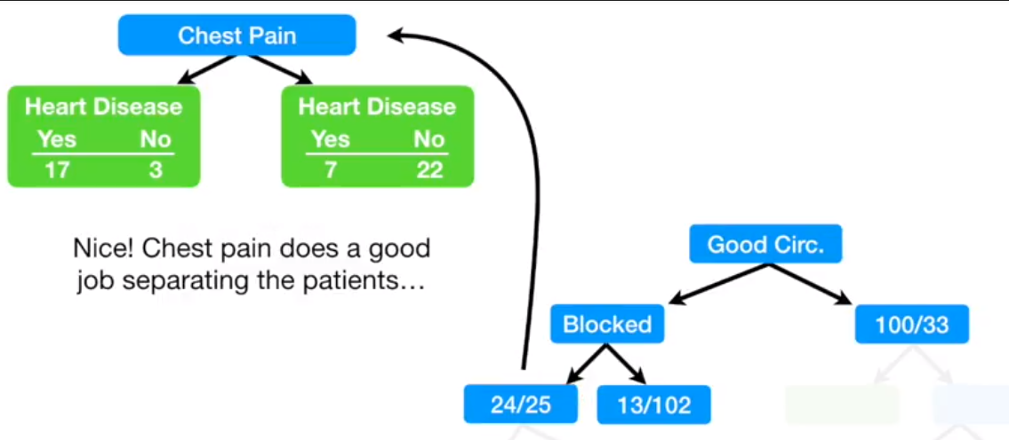
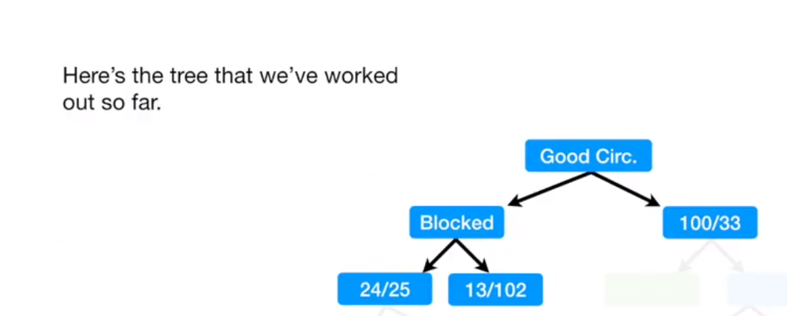
Decision Trees – Example Using Gini Impurity
Notes:
We are left with a pretty impure group on the left (Good circulation with blocked arteries)…how does chest pain question further help us?
What about the other side? (Good circulation with no blocked arteries)

Slide 18
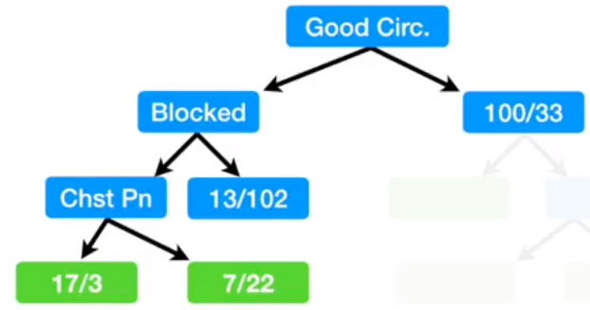
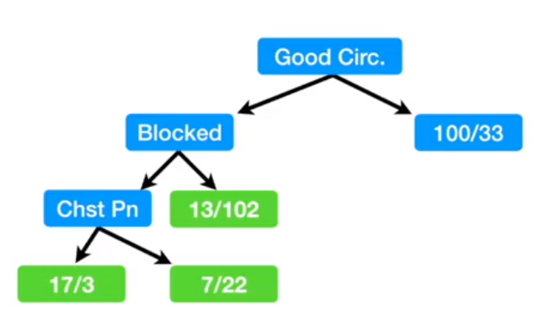
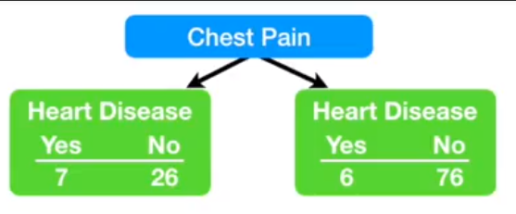
Decision Trees – Example Using Gini Impurity
Now we are here…how to we handle that good circulation without blocked arteries node? Do we use chest pain?
Use Gini impurity…
Right now that node has an impurity of 0.2
If we try to divide further with chest pain, the impurity = 0.29
So we make it a leaf node!
Notes:
We are left with a pretty impure group on the left (Good circulation with blocked arteries)…how does chest pain question further help us?
What about the other side? (Good circulation with no blocked arteries)

Slide 19
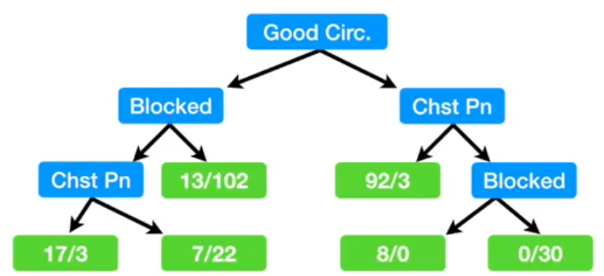
Decision Trees – Example Using Gini Impurity
Skipping forward, this is what our final decision tree will look like!
But what about numerical data? Like a patient’s weight?

Slide 20
Decision Trees – Avoiding Overfitting
Decision trees are particularly prone to overfitting…how can we avoid this?
Two main ways…
1) Setting constraints on tree size
Set minimum number of samples for node split
Set minimum number of samples for a terminal node (leaf)
Set maximum depth of tree (number of vertical splits)
Set maximum number of terminal nodes
Set maximum features to consider for splitting (feature selection!)
Note: Setting constraints on tree size is known as a top down or “greedy” approach
The tree will continue until a certain constraint is met without knowing what the results below could potentially be.
Notes:
Setting of constraints should be done through cross validation!

Slide 21
Decision Trees – Avoiding Overfitting
The alternative to setting constraints is pruning!
2) Pruning:
Steps:
Make a decision tree to a large depth
Start at the bottom and start removing leaves that are causing problems (very small, impure)
Can be automated in some advanced packages in Python and R (not available in Sklearn)
Notes:
Setting of constraints should be done through cross validation!

Slide 22
Decision Trees – Pros and Cons
Pros:
Easy interpretation!
Useful in data exploration
Requires less data cleaning
Not constrained by data type
Non-parametric model can fit complex relationships
Works well with noisy or incomplete data
Cons:
Prone to overfitting
Classification error rate can be high when your n is small and p is large

Slide 23
Decision Trees – Final Words
Decision trees are great for relatively complex, non-linear relationships when other simpler methods fail
Can be somewhat computationally expensive
Easy to interpret and visualize
Method can be utilized for even greater accuracy by using Random Forest

Slide 24
What are ensemble Methods?
A subtype of machine learning that combines several models to create a single predictive model.
Ensemble: combine many predictors:
Weighted combination of predictors
Can be made of many of the same type of model, may not
There are two types of ensemble methods:
1) Sequential
Base learners are generated sequentially and build off of each other
Example: AdaBoost
2) Parallel
Base learners are generated in parallel and are
Example: Random Forest

Slide 25



Ensemble Methods – Why an Ensemble?
Who remembers this show…
Contestant has two options for help…
1) Phone a Friend
Correct only some of the time
2) Ask the Audience
Very likely to be correct
Notes:
1) Phone a friend = perceived “expert” 2) Ask the audience = combination of “okay” predictors to make a single powerful predictor
- This is the general way that Ensemble methods aim to work

Slide 26
Ensemble Methods – How they make Predictions
By Committee
Simplest way to combine a collection of predictions
For Regression:
Unweighted average
For Classification:
Majority vote
Weighted Averages
Up-weight “better” predictors
Many mathematical ways to do this
Notes:
By Committee
Think about how the Who Wants to be a Millionaire question gives poll results…
Weighted Averages:
The better the predictor performs, the more important it’s predictions are in the ensemble model as a whole

Slide 27
Ensemble Methods – Bagging
Stands for bootstrap aggregation
Bagging uses bootstrap sampling to obtain the data subsets for training the base learners
It then aggregates the outputs of base learners
Voting for classification
Averaging for regression
Basic idea:
Average a noisy and unbiased model to create a model with low variance

Slide 28
Ensemble Methods – Boosting
A family of algorithms able to convert weak learners to strong learners.
Main principle:
Fit a sequence of weak learners (models that are only slightly better than random guessing, like small decision trees) to weighted versions of the data. More weight is given to examples that were misclassified by earlier rounds.
Notes:
Main Point: the data itself is weighted!

Slide 29
Ensemble Methods – Stacking
Ensemble learning technique that combines multiple classification or regression models via a meta-classifier or meta-regressor.
Less commonly used than bagging and boosting.
Steps:
1) Split training into two disjoint sets.
2) Train several base learners on the first set.
3) Test the base learners on the second set.
4) Using the predictions from 3 as the inputs, and the correct responses as the outputs, train a higher level learner.
Notes:
Stacking = example of a sequential ensemble method

Slide 30
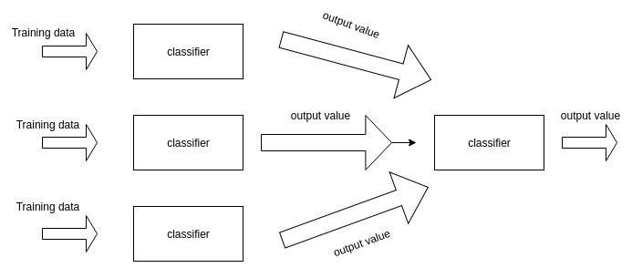
Ensemble Methods – Stacking

Slide 31
Random Forest
Versatile model capable of performing both regression and classification.
Can also be used for dimensionality reduction, filling missing values, identifying/removing outliers, and other essential steps of preprocessing.
It is a type of Ensemble method, where a group of relatively weak decision tree models combine to form a powerful model.
In general: the more trees in the forest, the more robust the model
Notes:
Random Forest is example of bagging

Slide 32
Random Forest – How does it work?
Steps:
Training: train multiple decision trees on a random subset of data
Prediction: when presented with a new observation (new data), the forest tries to predict its value.
Classification: The class with the most votes from the forest becomes our model’s prediction for that observation.
Regression: The average value of the forest’s predictions.

Slide 33
Random Forest – How does it work?
A bit more In depth:
1) Create random subsets of the data (with replacement)
2) Each tree is trained on this subset
3) Each tree makes predictions
4) When new data is presented and needs to be predicted, each tree casts a “vote” for whatever class is predicted
5) The model aggregates all votes made by the forest and chooses the class with the most votes as the final prediction
Remember, with regression this will be an average of all predictions

Slide 34
Random Forest – Parameters
There are some parameters that can help tune the model:
Number of estimators (trees)
If using a weighted forest model: minimum weight allowed in model
Any parameters used to tune decision trees!
Number of features allowed to be tried in each tree
Minimum samples to determine “leaf”

Slide 35
Random Forest – Pros and cons
Pros:
Can be used for classification and regression
Handles missing values better than most models
Is less prone to overfitting than most models (or single decision tree)
Handles large datasets or high dimensional data quite well
Cons:
While it can perform regression, it is not as well suited for such tasks
A bit computationally expensive with training so many decision trees as part of the forest
There is very little ability to control or tune model behavior (black box)

Slide 36
Random Forest – Applications
Commonly used in banking
Determining good customers
Fraud detection
Medicine
Identify correct combination of components when creating a new drug/treatment
Stock market
Classify stock behavior
eCommerce
Identify likelihood that a customer will purchase some item
Computer Vision

Slide 37
Random Forest – Final Words
Use when you are trying to model a large, complex dataset that a simpler model is struggling with.
Try when modeling non-linear complex relationships
If your single decision tree is overfitting, try using random forest!

Slide 38
Next Week
Deep Learning
Will include challenges and applications in biomedical research
What else?

